Slide 1
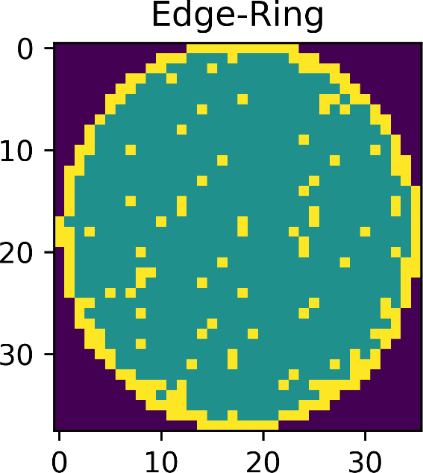
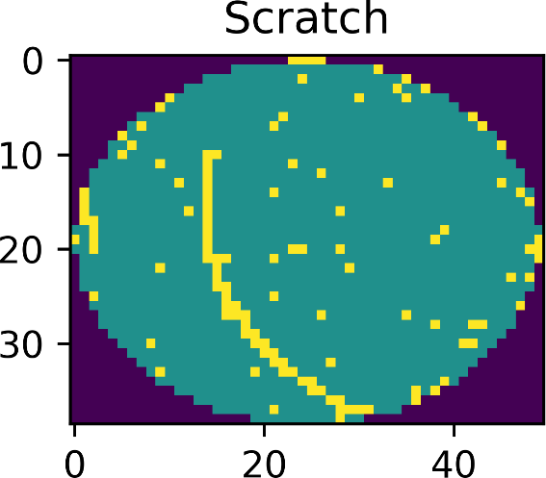
Dataset & Goal
~800,000 real wafer maps from with various failure patterns
8 pattern classes
Goal: Train a model to recognize failure patterns
Source: Public MIR-WM811K Corpus
http://mirlab.org/dataset/public/ https://www.kaggle.com/qingyi/wm811k-wafer-map

Slide 2
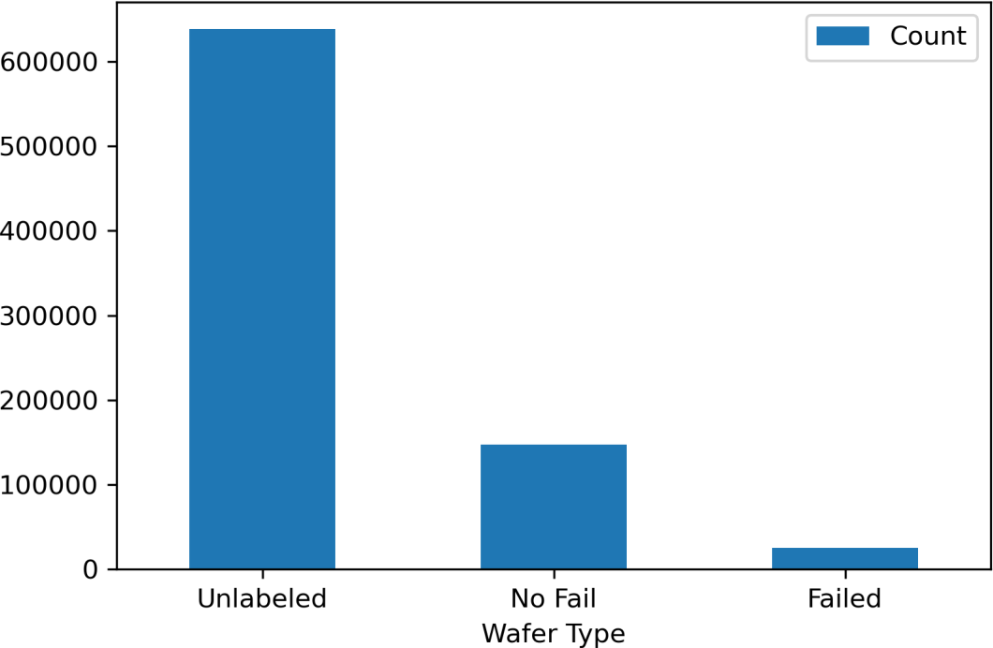
Data Cleaning
Only 25,000 failed & labeled
Dropped all others
Dropped extraneous columns
Die size, wafer index
Categorically encoded labels
Resized to uniform image size
Pixel values to binary grayscale
Formatted images for tensorflow

Slide 3
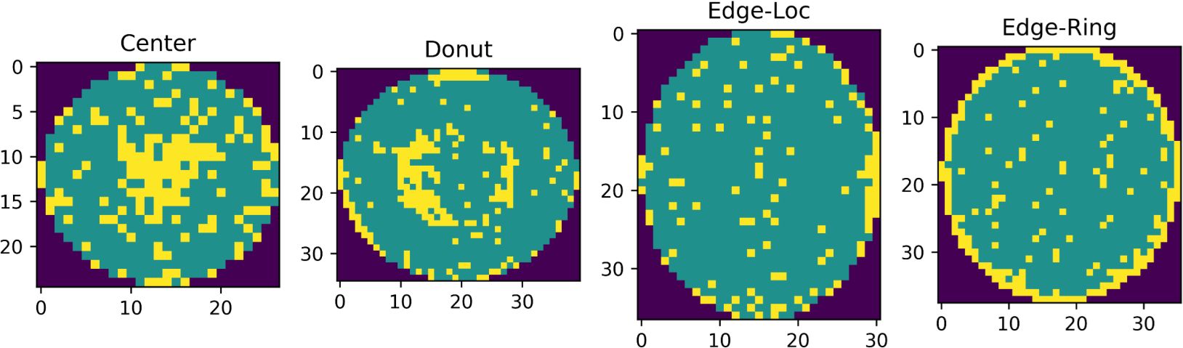
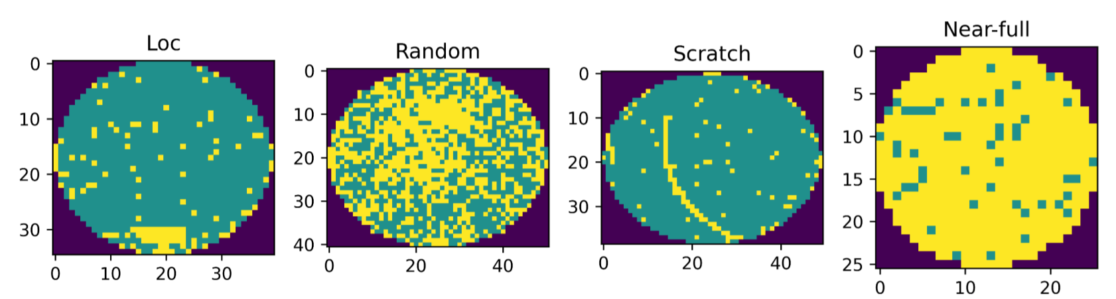
Image Classes and Dimensions
Various aspect ratios and sizes
Roughly 10x10 to 100x100 pixels
Resized all images uniform size
24x24
32x32
48x48*

Slide 4
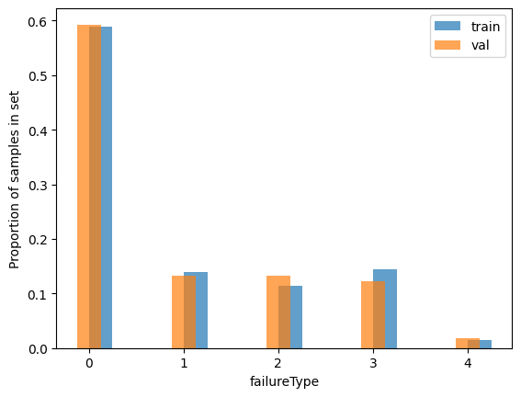
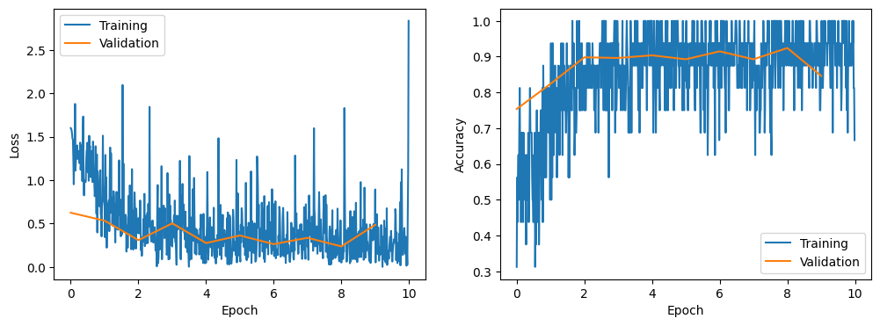
Training and Testing
Significant class imbalances
Mismatch of class distributions between training and test set
Using train/test labels included in dataset
Training Set
Class distribution (training)
Class | Percentage
Center | 19.6
Donut | 2.3
Edge-Loc | 13.7
Edge-Ring | 48.5
Loc | 9.2
Random | 3.5
Scratch | 2.8
Near-full | 0.3
Test Set

Slide 5
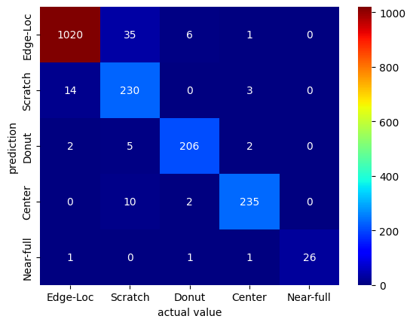
CNN Model And Results
Input dimensions: 48x48x1
Dropout and pooling layers to prevent overfitting
Final activation of softmax for multiclass classification
Training Results=loss=0.1205961278026, accuracy=0.9658730158730159
Testing Results=Loss=0.21907317556221695, accuracy=0.9259259259259259)

